Slide 1
Councils with ALMOs Group Finance and Business Planning 22nd January 2025 Steve Partridge Director, Head of Housing Consultancy

Slide 2
Introduction
Expenditure Pressures and Business planning for 2025/26 onwards
Recap: what we have been saying to government since the autumn
Rents consultation analysis
Right to Buy consultation and changes
New build prospects
Any other issues
2

Slide 3
HRA financial pressures and business planning

Slide 4
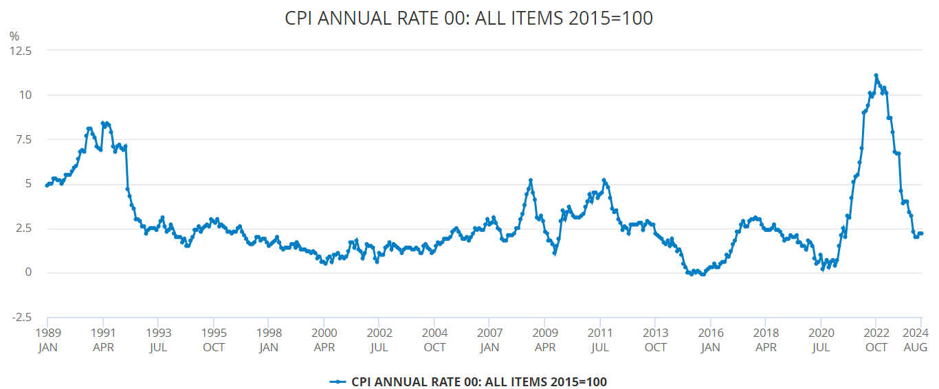
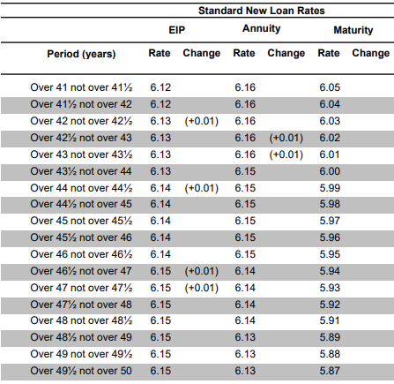
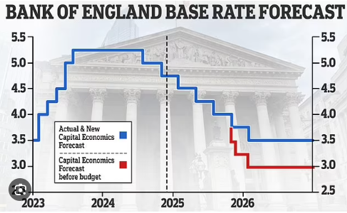
Economic pressures
Evidence that pressures remain well above CPI & BCIS
4

Slide 5
Economic -> financial pressures
A return to CPI+1% for rents for 2024.25 and 2025.26
7.7% maximum increase in April 2024 – but 2.7% maximum increase in 2025.26
Relet at target / formula
Convergence could be quicker (see later)
Long-term rent policy trailed – consultation now
Pressures are in many places have been greater than 7.7% - and are definitely more than 2.7%
Locally dependent BUT still up to 15% on average
AND will already have inflation baked into 2022.23 and 2023.24
National insurance costs a challenge
Many having to make deep cuts – or use reserves
 | 2025.26 | 2026.27 | 2027.28 | 2028.29
General CPI | 2.50% | 2.00% | 2.00% | 2.00%
Pay award | 5.00% | 4.00% | 4.00% | 2.00%
Contractors | 6.00% | 5.00% | 2.00% | 2.00%
Supplies/materials | 6.00% | 5.00% | 2.00% | 2.00%
Utilities costs | 5.00% | 4.00% | 2.00% | 2.00%
Construction / capital | 5.00% | 3.00% | 2.00% | 2.00%

Slide 6
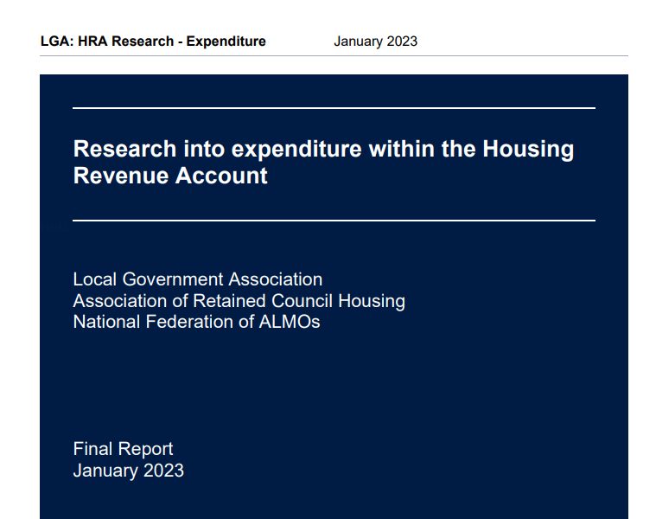
Previous research for the LGA, ARCH and the NFA
Commissioned during the autumn of 2022 in three stages:
HRA rents and income – fed into the rent cap consultation November 2022
HRA expenditure – published early 2023
Right to Buy – backward and forward projection, recommendations in relation to use of receipts – informed recent changes re discounts and eligibility
Updates to feed into new government and SoS
Rent and income update focused on implication of rent policy and predictability
Expenditure update, key focus
Key previous expenditure headlines…
Inflationary pressures on capital and repairs, headline inflation > CPI/BCIS
Fire, building safety - £7.7billion 2023-2030
EPC C and NZC - £23billion 2023-2050 (front-loaded on energy efficiency)
Revenue pressures vie professionalisation - early estimate c£150million
Other regulatory pressures downplayed
New build costs and funding increased implying grant increases of £25-45k/unit
SO… how have these things moved on since the autumn of 2022?
Strong feeling that the dial moved significantly further in the last 12-18 months / 2 years – and continues to move
6

Slide 7
Capital investment requirements
Life cycle replacements, revised Decent Homes Standard, remaining costs re Fire and Building Safety
EPC C by 2030 and Net Zero Carbon by 2050
Extensive local authority feedback
Average investment profiles between £58,000/unit over 30 years up to £90,000+/unit
Linked to expectation of DHS2
Combination of “inflationary” and “supply chain” pressures and “higher standards”
Description | Amount
No / % of authorities | 33 / 20%
No of properties / % | 399,855 / 25%
30-year totals
Maximum | £ 101,374
Minimum | £ 32,913
Average (weighted) | £ 61,983
Business plan sample profiles
Significant increases against previous totals, even from 2-3 years ago
As stock surveys progress, totals are pushing up – why?
If prices are stabilising?
Parallel experience in the housing association sector re affordability
Driven by regulatory engagement and Regulator saying “data, data, data”
Are surveyors pricing more risk into their survey totals now?
Is the condition of stock worse than we thought?
7

Slide 8
Capital investment requirements
For reference…
The original self-financing settlement upon which HRA finances are based averaged £30,701/unit over 30 years for life cycle replacements
With general CPI inflation – 35% - this would now be the equivalent of £41,500/unit over 30 years
With BCIS maintenance (tender price) inflation – 56% - this would now be the equivalent of £48,100/unit over 30 years
Both are substantially below where costs and prices currently are and projected to be
Example elements… kitchen provision in 2012 = £3,000 (average), with CPI would now be just over £4,000
Currently averaging £5,500-£8,000
8

Slide 9
Capital investment requirements
Energy Efficiency
EPC C and above average estimated to be 65% - 35% to go of which ¾ will require specific investment
Average improvement works now over £9,000 – previously reported at £7,700 - in London substantially more than that
Decarbonisation
Significant adverse feedback on the operation of the SHDF programme
Both from a matching and a reporting/complexity perspective – nothing new of course but in the light of new gov’t?
Net Zero – typical allocation £25k/unit on top of EPC C – feels “low” – we are still in the £25billion ball park
Engagement with DES-NEZ critical in establishing a longer term plan
BUT… focus has shifted towards the basics
9

Slide 10
Awaab’s Law and Repairs
Strength of feeling towards challenges around delivery of Awaab’s Law
Following consultation earlier this year)
Damp, mould and condensation
Average around 20% of all properties subject to some form of engagement/complaint in 2-year period
Litigation and disrepair claims – again widely varies but in some cases significant
Impact on responsive repairs from ongoing stock surveys – HHSRS (health & safety) hazards
Average increases in repairs budget allocations – 12%+ to 2024.25
BUT… actual costs are higher, in some cases significantly
Volumes are higher (demand) / rates are higher (prices)
Very common for LAs to be modelling a reduction in repairs in the next 2-3 years
To bring the HRA back to balance - how realistic is that?
10

Slide 11
“Professionalisation” and Regulation
Feedback re professionalisation feels challenging
Application / range / scope
Which disciplines
Qualification vs Experience
Experiences vary with many authorities limiting to senior staff but some considering wide application
Qualification costs - £8-15million (£5-£10 per property per year)
Backfilling costs - £50million + (£30+ per property per year)
Regulation and Ombudsman: two elements…
Specific costs of regulation and THO subscription
Estimated between £25-35million across the entire HRA sector
Additional costs to meet the Standards
Varies significantly but almost all allocating additional officers to areas such as TSM management,
tenant engagement, tenant empowerment, service improvement
11

Slide 12
Rent: Budget 2024 and the Consultation
On the face of it, a Budget with understanding of the need for more income and more investment
Core proposal within the Budget is to firm up rent increases for 5 years 2026-2031
Additional options around rolling 5-year settlements or up to a 7 or10-year settlement
Core proposal also to allow increases up to CPI+1% pa (up to 10 years)
Other questions around additional funding options for social housing providers
BUT – does not provide for
“Convergence” back to formula rents
Reopening the whole “formula basis” for social rents
All in the context of what additional capacity for investment a stable rent policy might be able to deliver
Also… Right to Buy restrictions on maximum discounts and eligibility – may help long-term HRA viability
12

Slide 13
Rent policy: just how important is it?
Two projections … to inform consultation (More later!)
Meeting up front investment needs through additional borrowing
Charts show…
Top – enormous forecast deficits with rents at CPI only
Bottom – forecast with rents at CPI+1% for 10 years and convergence to formula rents in 10 years
In practice convergence may go quicker
Key take aways…
Need CPI+1% policy to “survive” even before thinking about new build/regeneration
BUT not even CPI+1% addresses the very short-term pressures – need for an immediate cash injection?
13

Slide 14
The average is just an average: LA types?
TYPE 1: “WILL BE OK”
Decent services
Low non-decency rates
Low numbers of high rise
Reserves positive
Didn’t wait for enhanced regulation
Maintaining new build
TYPE 2: “SHOULD BE OK”
Reasonable services
Capital needs manageable
Backlogs can be managed
Borrowing can be controlled
Some new build remains
Needs focus, efficiencies and savings
TYPE 3: “IN TROUBLE”
Service pressures extensive
Low levels of reserves
Lots of high rise
High levels of non-decency
Surveys coming up with huge investment totals
Just… not the money for everything to be done
HRA: 3 TYPES
ALL NEED VERY CAREFUL MANAGEMENT: HOW MANY OF EACH TYPE?

Slide 15
Summary: not enough money in the HRA system
We operate under a system that was introduced in 2012
Intended to be “self-financing” by setting a level of debt linked to future rents and future costs
Assumed that the Decent Homes Standard had been met and set so it could be maintained
BUT NOW… time has moved on and the assumptions that were made no longer apply
Rents have not been allowed to increase as originally planned (for 4 years they were cut)
Rent income is c£1.2billion lower in 2024.25 than it would have been with no interventions
Standards are much higher now – energy efficiency, Building Safety, enhanced Decent Homes Standard to come
We are only part way through the upgrade – and DHS2 compliance is patchy at best
Inflation has not been cyclical – there has been a structural leap in capital and repairs costs
Cost pressures higher than core CPI, even BCIS indices, and unlikely to be reversed
Repairs demand significantly spiked at a time of restricted contractor and skills capacity
Regulatory burdens are increasing with no compensating funding
Interest rates are up (driven by gilts not by BoE rates) and show no sign of a short-term decline
Development costs have risen sharply and may not be levelling out everywhere
If the nation wants good quality, sustainable council housing, more money needs to be invested
15

Slide 16
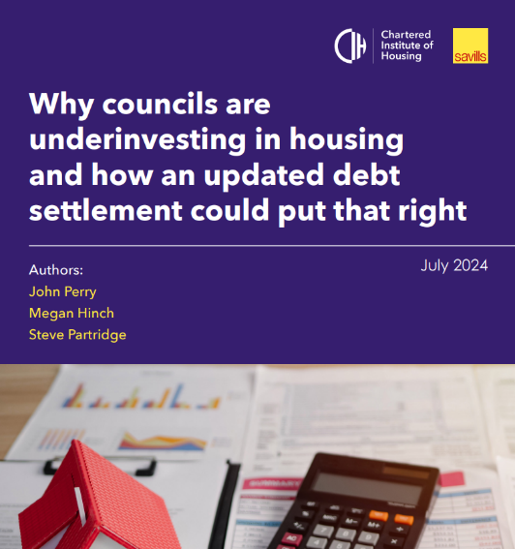
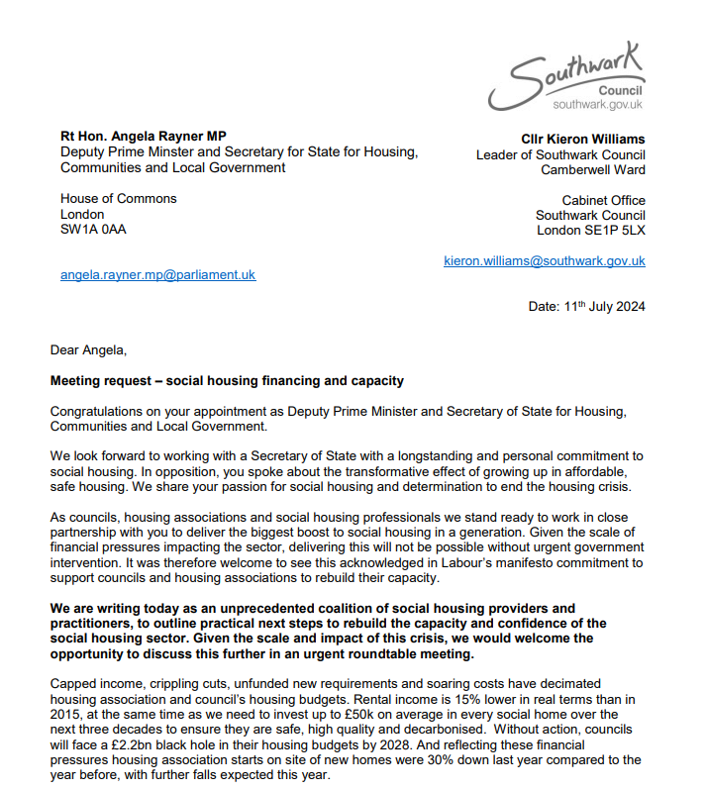
Activity and action
Range of initiatives to lobby into the new government
16

Slide 17
Securing investment: national to local
IN THEORY, there are only four ways we can more money into the system…
MORE INCOME: Allow rents to increase greater over a longer period of time
MORE GRANT: Greater capital subsidy and grants
Fire/Building Safety limited?
Social Housing Decarb Fund popular for resources but unpopularly inflexible – and extremely limited
Local Authority Housing Fund feedback generally positive
NEW INCOME SOURCES:
Around net zero, warm rents, increased service charges etc
REDUCE (OR WRITE-OFF) HRA DEBT: Reopen the HRA debt settlement
Work undertaken for Chartered Institute of Housing
IN PRACTICE, likely to need a move forward on all of these fronts
BUT – apart from rents for 5 years…
we can’t assume any of these
Locally, experiences differ and many LAs are in a reasonable place, some are under significant and intensive pressure
17

Slide 18
Southwark report
5 solutions to secure the future of council housing
Led by Southwark public affairs – initially top 20 landlords – eventually signed by 100 authority leaders
Establish a fair and sustainable HRA model
Not just income, not just expenditure, all of the components of a sustainable FRAMEWORK
Reform unsustainable Right to Buy
Broadly… responded to positively by the government
Remove red tape on the affordable homes programme and other funds
Homes England changes – a new AHP for 2026+
Green and Decent Homes programme
Grant and other top up funding for EPC C by 2023 and NZC by 2050
Fund the completion of new council homes
Specific funding of stalled and other challenging sites that could be led by councils
18

Slide 19
Stress testing – learning from HAs?
RSH driven stress tests articulated as generic changes in key assumptions
Liquidity
Resilience
Long-term risk exposure
Framed in the context of “meeting commitments” - typically taken to mean debt obligations
Forecasting revenue, debt and the capital programme are relevant HRA outputs
M&M costs up 10% from yr 1 / M&M costs significant additional pressure year 1/2
Reduced / increased inflation -1%
Increased interest rates +1%
Increase in voids/bad debts to 10%
Rental inflation real -1% for 5 years
Real increase in cost inflation +1%
Major repairs cost inflation + 1% real
Major repairs costs dial changed arising from stock survey +30%
Multi-variate: Rent inflation real negative for 5 years, cost inflation real positive, voids/bad debts big increase, significant rise in capital investment needs
Extensive and significant changes to factors – to demonstrate low probability
The multi-variate scenario – why it is unable to happen
Generic to locally specific…
19

Slide 20
Scenario planning and stress testing: example
Downside / stress testing
Response repair costs continue to increase albeit with planned savings
Ongoing savings from (say) 2026/27 unable to be delivered
General inflationary pressures on supply chains for repairs and capital
EPC C and Net Zero Carbon
Awaab’s Law and longer-term pressure on repairs
Regulatory pressures / professionalisation
Voids and arrears pressures
Development costs increase – takes longer to deliver new build and regeneration schemes
141 RTB receipts fall away (see upside)
LINK TO RISK REGISTER / MAPPING
Upside -> use of headroom
CPI+1% rent increase for 10 years (or for 30 years?)
Right to Buy sales decline leading to retention of more net rent income (see downside)
Right to Buy net receipts increase more than anticipated as discounts reduce
Increased development and acquisition programme or identified efficiencies
Delivering further efficiencies from service transformation
Reducing increase in operational costs to improve operating margin
UNDERSTANDING SERVICE, INVESTMENT, TENANT AND MEMBER PRIORITIES

Slide 21
Rents consultation analysis

Slide 22
Rents analysis: themes
Work undertaken for CIH pre-Christmas to inform consultation responses
Partners included CWAG
Rent increases and convergence
Capacity within the LA and HA sectors – rent policy impacts
What might it mean for the HRA debt settlement?
Affordability
Relationships to private sector rents
For tenants
22

Slide 23
Average rent forecasts – local authorities
Headlines
Average rent in 2023.24 was £99.32
Average formula rent in 2023.24 was £105.06
Average “gap” between actual and formula rent was £5.74 or 5.47%
CPI+1% for rents over 10 years with no convergence would result in average rents of £149.21 compared to £135.36 for CPI only increases
Average formula rents increasing with CPI+1% would be £157.85 by 2035.36
Rent increases at CPI+1%+£3/week would result in convergence with average formula rents in 2032.33
Rent increases at CPI+1%+£2/week would result in rents within 5p/week of convergence with average formula rents by 2035.36
LA RENT CONVERGENCE

Slide 24
Additional rent income – local authorities
HA RENT IMPLICATIONS
Headlines for rent increases at CPI+1%
Cumulative annual in-year impact of CPI+1% increases (compared to CPI only) increases = £1.1bn per year by 2035.36 – the impact of which would continue all years beyond 2036; this totals cumulative additional income in 10 years = £5.6billion or an estimated cumulative £31billion over a 30-year business planning period
For CPI+1% for 5 years, the impact is much reduced to £0.48bn per year by 2030.31, cumulatively £16billion over 30 years
Additional rent income from convergence scenarios | £2 / week convergence | £3/ week convergence
In year impact by 2035.36 | £674m | £685m
Cumulative additional rent income 10 years | £5,516m | £5,970m
Headlines for convergence
The total additional rent income over 10 years from convergence including relet at formula rent and weekly additional convergence factor on top of CPI+1% at:
£2/week: £5.516billion
£3/week: £5.970billion
Additional rent income from reletting at formula rent at CPI-only rent increases would be c£2billion

Slide 25
National projections: updating our baseline forecasts
Implications for capacity and delivery from rent policy scenarios
Need to understand expenditure pressures – these have intensified during the course of 2024
Large proportion of any additional rent income will be required to address additional expenditure pressures
NI changes: added 2.25% applying to 65% of management costs and 15-20% of maintenance costs
Lower September 2024 inflation reduces 2025.26 rent income by c£65m for LAs
Costs rising well above CPI for repairs and capital, for LAs significantly above 10%
Offset (slight): lower RTB sales volumes result in retention of more net income over the long term
The HRA forecast is worse in the early period (NI/costs) but improves within a few years as a result of many fewer RTBs
HA/LA PROJECTION BASELINE

Slide 26
National projection: local authority HRAs
Key headlines
At CPI only rent increases, cumulative HRA deficits are over £12billion by 2036.37
CPI+1% for 5 years improves to a cumulative deficit just below £8billion
CPI+1% for 10 years stabilises net rent income by 2036.37
Rent convergence at either £2 or £3 week delivers cumulative surpluses of up to £1.0billion by 2036.37
Potentially enables all existing stock pressures to be addressed with some capacity for additional development
BUT this does only take effect from 2034 – implying that deficits will need to be addressed by resources other than rent policy in the medium-term
Additional resource injection implied to cover immediate and short-term pressures and to unlock development capacity
LA SECTOR PROJECTION

Slide 27
HRA debt settlement: implications of scenarios
Impact on HRA debt settlement of various changes to rent policy £m | Rents CPI+1% all years from 2026 | Rents at CPI-only from 2026 | Rents CPI+1% for 5 years only from 2026 | Rents CPI+1% for 10 years only from 2026 | Rent convergence £3/week from 2025 | Rent convergence £3/week CPI+1% for 10 years only
Original settlement | 29,188
Revision for authority numbers | -503
Recast original settlement | 28,685
Revision for rent policy (rent cuts 2016-2020 and rent cap in 2023) | -10,184 | -11,980 | -10,970 | -10,411 | -8,638 | -8,759
Revision for higher fire/building safety standards | -4,535
Revision for capital repairs inflation which will not be reversed | -1,555
Revision for enhanced regulatory pressures | -0.932
Revision for reduced property numbers due to RTB discounts | -228
Speculative consolidated revised settlement | 11,251 | 9,455 | 10,465 | 11,024 | 12,797 | 12,676
HRA DEBT
Work undertaken for CIH summer 2024 – headline: settlement should be reduced to £11.251million as a result of policy changes and increased standards
Updated to apply various options for the future of rent policy Key points:
The original settlement envisaged rent increases at RPI+0.5% for 30 years (equivalent to CPI+1%) – the revision to £11.251bn therefore contains an assumption that rent increases would be CPI+1% in all years from 2025 onwards with no rent convergence
If increases are CPI+1% for only 10 years – the settlement would reduce to £11.024bn
If increases are CPI+1% for only 5 years – the settlement would reduce to £10.465n
Conversely, allowing rent convergence at £3/week would increase the debt sustainable by HRAs to £12.797bn with CPI+1% for all years– and if CPI+1% was only allowed for 10 years, to £12.676bn
Key conclusion: cumulative impact of rent policy changes to 2024 are the biggest impact on HRA sustainability

Slide 28
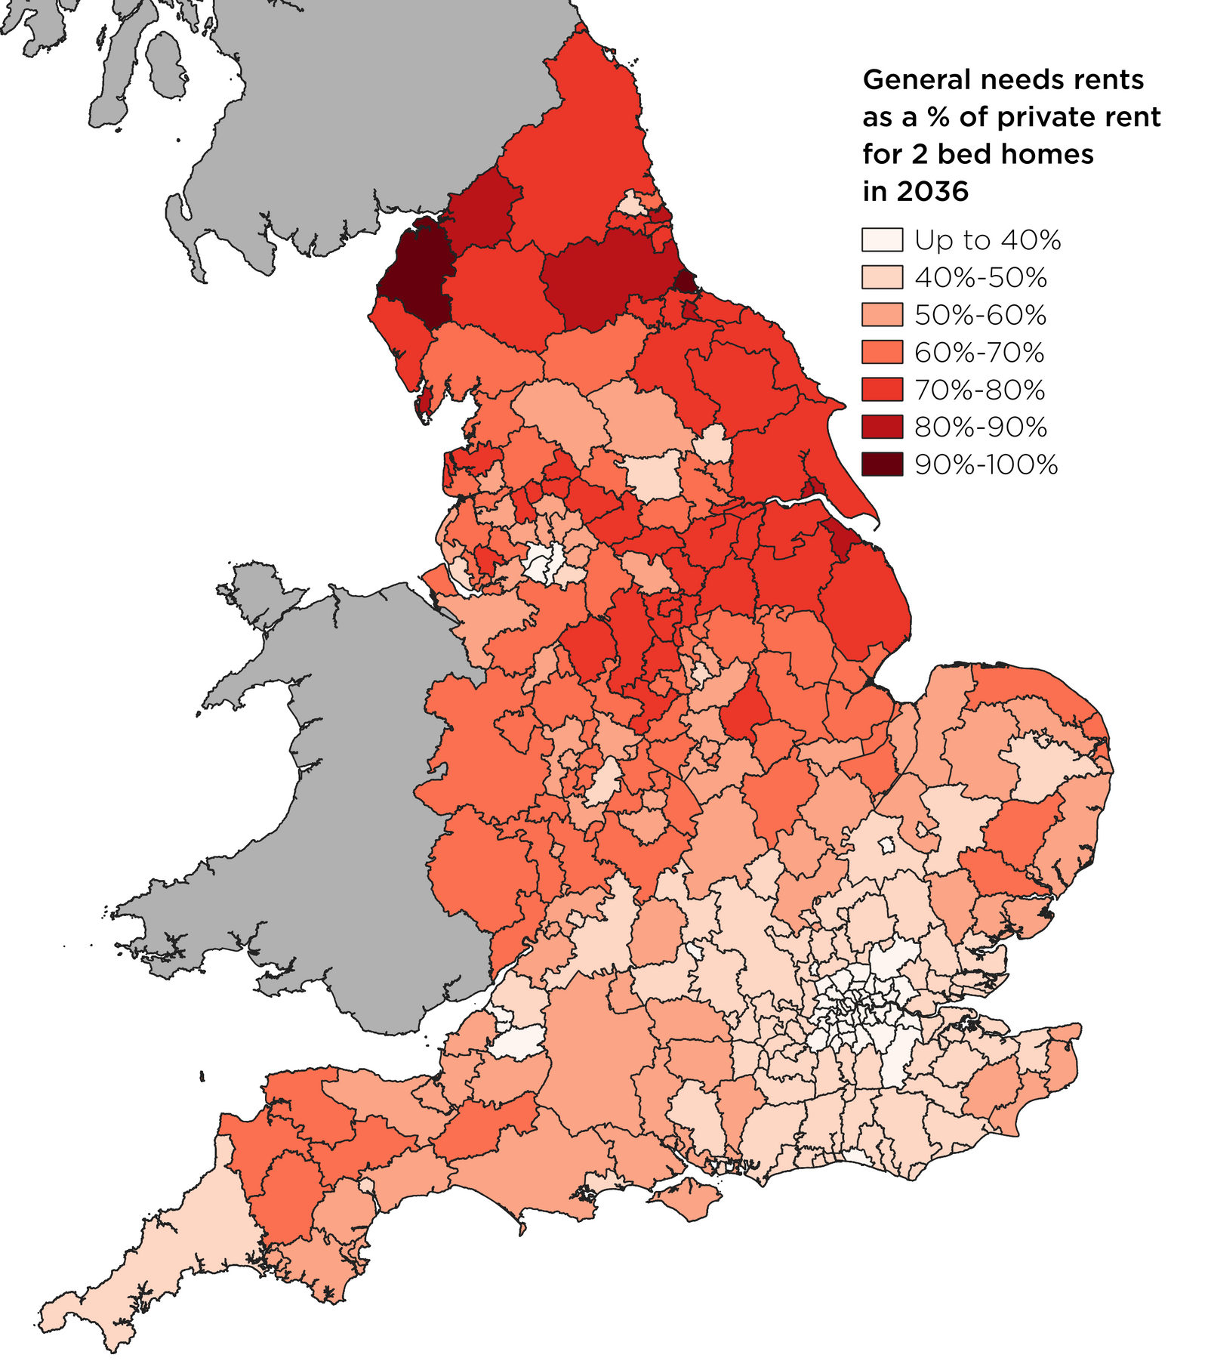
Affordability: rents relative to the private sector
Savills research into the relative affordability of social rents against market rents undertaken in the summer of 2024
Relative affordability of social as a result of the introduction of a social rent policy of CPI+1% increases for 10 years from 2026-2036
Comparing social rents forecast over 10 years at CPI+1% increases against Savills forecast for market rents over the same period at the LA level
Exemplar 2-bed social rented housing association home utilising average rents at the LA level from the SDR 2024 (noting that equivalent LA rents are c7% below HA levels)
The analysis shows that:
Social rents stay well below market rents in virtually all parts of the country
In London and the South East, CPI+1% rent increases for social rents maintain them below 50% for most LA areas
Only in a handful of authorities (those with an under-developed market rented sector), would social rents rise above 80% of market rents over a 10-year period
The results highlight that there should be confidence that a rent increase policy of CPI+1% will not fundamentally change the relative affordability of social rents compared to the private sector
AFFORDABILITY: RELATIVE

Slide 29
Affordability: for tenants and residents
All depends on how incomes grow
Apply differential wage growth assumptions –
Low CPI only
Central CPI+0.25% (2.25%)
High CPI+1%
Compared to growth in rents at CPI+1% with £3 convergence to estimate a £/week pressure
The charts show that:
Central wage inflation forecast leads to approx. £8 / week additional income that needs to be found to meet higher average rents over time
Driven by rents rising at CPI+1% (3% pa) and wages forecast at 2.25% pa
If wage growth is “stagnant” (CPI-only say), implied additional affordability pressure is c£12/week by year 10
If wages increase at CPI+1%, the pressure is c£2/week
However…
The longer-term pressure on affordability arises from CPI+1% being higher than wage inflation
AFFORDABILITY: TENANTS

Slide 30
Right to Buy Changes and consultation Responses discussion

Slide 31
Right to Buy discussion
Budget announcements and changes
Restriction of discounts from 21 November 2024
Cost floor extension
Retention of receipts
Some questions…
Experience of ”spike” in applications in the run up to 21 November 2024?
Have conversion rates been higher or lower compared to the long-term average?
What impact on gross receipts?
Treatment of the Local Authority share – experience locally?
Any other points to pick up from the changes already made?
31

Slide 32
Right to Buy consultation: themes
Eligibility
Time in the tenancy – 3 years to….
Discounts as a %age of property value
Generically a potentially large reduction to maximum discounts – to fit with the revised cash caps
No move to set maximum only in relation to %age discount
Exemptions
Sheltered and other extra-care / specialist = the main theme over time
Are there any others?
Properties after sale
Longer period for which LA to be able to re-acquire
Discount recovery
32

Slide 33
Right to Buy consultation: themes
RTB receipts re-investment
Discussion around where and what replacements should be
Linked to those properties that have been sold – 1-bed for 3-bed
Can it be made to stack up?
RTB receipts re-investment (updating the 141 approach)
Simplification - already have 100% retention - indefinitely
Relaxation of restrictions on acquisition; relaxation on restrictions on buy-backs
Use of (the current) LA share for reinvestment in new homes – how much of an issue might this be?
Using RTB receipts alongside grant
“Double subsidy” issue?
Invited examples of where this would work well to unlock investment
33

Slide 34
Right to Buy consultation: summary
Broadly speaking…
Does this consultation cover much (if not all) of the issues that have been raised by local authorities ?
Particularly since 2012 and the reinvigoration at that time
Some areas where MHCLG proposals may not align…
Local authority set discount policies (for example)
Continued reference to double subsidy with grants and RTB receipts
Some LA General Funds may have issues with the LA share proposals
However, in overall terms…. Views?
34

Slide 35
New Build update

Slide 36
New Build pressures
Implications for programmes of pressures on the HRA
Quick update re experiences
Progress of New Build plans
36

Slide 37
HRA pressures and new build
Three principal implications
Scaling back new supply
Deferring programmes and schemes
Switching from development to acquisition
Even in the most pressured HRA scenario, addition of some new supply is seen as essential
Members always positive
Can new build and acquisition programmes continue if the rest of the HRA is under so much pressure?
Key =
De-risking development
Viable from the “get go”
Partnerships and new methods for delivery
Sharing resources / combined and mayoral authority economies?

Slide 38
Viability hurdles
STANDARD METRICS AND HURDLES
Usual appraisal models and techniques used by developers do not apply straightforwardly to the HRA
Not a reason for not assessing viability
HRA specific issues include:
Need to allocate resources for major repairs from year one
Cannot capitalise development interest – which means HRA cross-subsidising until built
Opportunity for “marginal costs” for management and repairs allocations
Opportunity for “marginal” interest cost
Net Present Value
30, 40, 50 years or longer?
Before subsidy
After subsidy – do you want it to be above zero?
Internal Rate of Return
30, 40, 50 years or longer?
After subsidy – what is a sensible minimum: 4%, 5%, 6%?
Loan payback
30, 40, 50 years or longer?
Measured from… when?
Start of development or PC/stabilised

Slide 39
Viability: HRA specifics
Example of a scheme that is viable in the conventional sense: pays back in 40 years and considerable value to the HRA over the long-term
BUT deficit interest in the immediate post-PC period – requires HRA subsidy for that period
KEY = minimising cross-subsidy implications whilst protecting viability overall ?

Slide 40
Funding routes
Affordable Homes Programme
Grant rates are higher
But do they reflect a “stack up from day one”
Or do they reflect the fact that housing associations have traditionally been able to cross-subsidise from capacity within their business plans?
Criteria applied for funding -> often seen as inflexible
Limited track record of delivery for local authorities
No strategic partners
LAHF programme
Seen as a more flexible funding route
Speed of delivery
Applying variably to meet need for new build and/or acquisition
Can reduce or eliminate cross-subsidy
Ease of access and open to all
As far as possible, aim for schemes to “wash their face from day one”
In practice, virtually impossible in many cases
Aim to minimise impact on the reset of the HRA
Options and opportunities
AHP grant
Other Homes England / GLA grants
Right to Buy receipts – but may become more restricted despite 100% retention
LAHF programme
141 Right to Buy receipts
Have been hamstrung by complex rules and returns
Match funding, cap on acquisitions, time to deliver
Insufficient to return one for one
The most flexible route (except for acquisition cap under consideration)
No need for bidding

Slide 41
Measuring success
Despite a rush for RTB applications to 21 November, we can expect a big drop of sales from next year onwards
MHCLG estimate 1,700 pa – fewer than the 2011.12 level (2,000+) – 0.11% pa
This might give a genuine opportunity to replace sold stock and a net growing HRA as a key business planning objective…
… providing the subsidy is available at the right level to make schemes viable
Overall, a business plan with lower push to deficit after 30 years – maybe eventual surplus - but does not address sustainability in the earlier years
Addressing temporary accommodation challenges
Why the HRA and not the General Fund?
Flexibility in allocations and lettings – can switch between uses ?
Finally… English Devolution White Paper – into the Spending Review

Slide 42
Thank you – any other issues? Steve Partridge Director, Head of Housing Consultancy steve.partridge@savills.com 07968 354948

