Slide 1
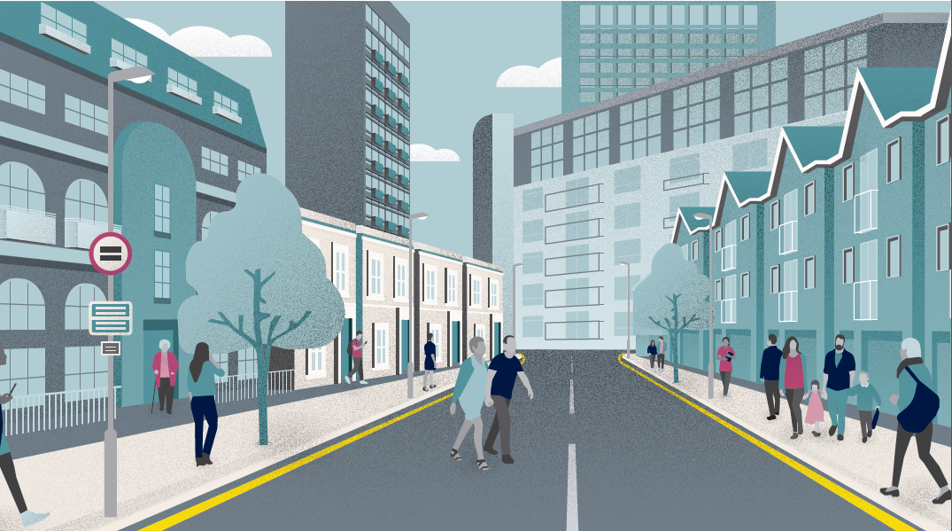
COUNCILS WITH ALMOs GROUP
Business planning and financial update
18 January 2024
Steve Partridge & Simon Smith
Director / Associate Director
Savills Affordable Housing Consultancy

Slide 2
Introduction
ECONOMIC BACKDROP
FINANCE AND BUSINESS PLANNING
HRA TECHNICAL AND RING-FENCE ISSUES
FUTURE CAPACITY?
REGULATION PREPARATION

Slide 3
ECONOMIC BACKDROP

Slide 4
Inflation set to ease as rates reach peak
Notes:
At the top of the rate cycle

Slide 5
The economic drivers
2021
2022
2023
2024
2025
2026
2027
2028
Notes:
LRC

Slide 6
UK Mainstream Forecasts; November 2023
 | 2024 | 2025 | 2026 | 2027 | 2028 | Total
Average UK house price (Savills) | -3.0% | +3.5% | +5.0% | +6.5% | +5.0% | +17.9%
Housing Transactions (Savills) | 1.04m | 1.14m | 1.16m | 1.16m | 1.16m | N/A
Notes:
LRC

Slide 7
Outlook for transactions
First time buyers
2023: 280k
2024: 290k
2028: 340k
Home Movers
2023: 250k
2024: 280k
2028: 330k
Mortgaged Buy to Let
2023: 50k
2024: 50k
2028: 70k
Cash
2023: 430k
2024: 430k
2028: 420k
Total
2023: 1.02m
2024: 1.04m
2028: 1.16m
Notes:
EW

Slide 8
Regional price forecasts
Notes:
EW

Slide 9
Moving in cycles
 | London | UK | Difference
2024 | -4.0% | -3.0% | -1.0%
2025 | +2.0% | +3.5% | -1.5%
2026 | +4.0% | +5.0% | -1.0%
2027 | +6.0% | +6.5% | -0.5%
2028 | +5.5% | +5.0% | +0.5%
Notes:
EW

Slide 10
Higher value, mortgage dependent markets closest to London more exposed to affordability pressures
Recovery is likely to come from mid-2024 onwards once interest rate cuts are on the horizon
Towards the end of five-year period, price growth across regions is expected to converge
Fewer transactions are taking place but cash buyers and first time buyers are still motivated
Notes:
FMM

Slide 11
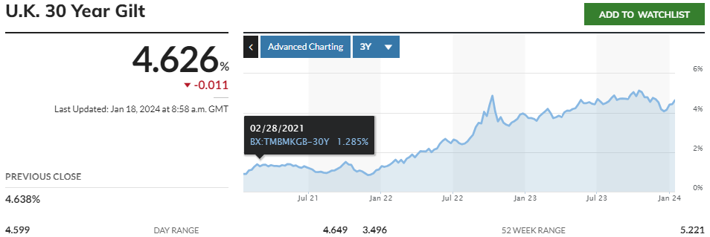
Economic pressures affecting council housing

Slide 12
FINANCE AND BUSINESS PLANNING

Slide 13
Economic pressures undiminished for HRA landlords
A return to CPI+1% for rents
7.7% maximum increase
Relet at target / formula
Catch up consultation has not (to date) happened
What about long-term rent policy?
BUT pressures are in many places greater than 7.7%
Locally dependent BUT still up to 15% on average
AND will already have inflation baked into 2022.23 and 2023.24
Savings in 2023.24 – or dipping into reserves?
Autumn Statement implies CPI+1% continuing – for how long?
Driver | R&M | Management
Employee/pay | 25% | 65%
Contractor | 50% | 15%
Supplies/materials | 25% | 10%
Utilities |  | 10%
 | 2024.25 | 2025.26 | 2026.27 | 2027.28 | 2028.29
General CPI | 6.00% | 2.00% | 1.00% | 2.00% | 2.00%
Pay award | 5.00% | 4.00% | 2.00% | 3.00% | 3.00%
Contractors | 7.00% | 2.00% | 2.00% | 3.00% | 3.00%
Supplies/materials | 7.00% | 2.00% | 2.00% | 3.00% | 3.00%
Utilities costs | 15.00% | 5.00% | 2.00% | 3.00% | 3.00%
Construction | 10.00% | 5.00% | 2.00% | 3.00% | 3.00%
Real rents from 2025 |  | 1.00% | 1.00% | 1.00% | ??

Slide 14
Revising national projections
Last year’s projection based on 7% cap (if fully implemented across the sector)
Implied savings of up to £250million to balance HRAs
Some will have drawn on balances – or borrowed capitalised some expenditure
This year’s projection – on the basis that savings were made to balance HRAs in 2023.24… Reserves policy important (see later)
Long-term, projection retains surpluses but in the short-medium terms, catch up via relets implies ongoing deficits to be managed
2-year implied deficits – suggest further 3-5% of M&M cost savings across the HRA sector
10 year catch up to formula might mitigate some medium term impacts and allow better planning over the long term

Slide 15
What if savings had not been made?
IF savings had only partly been made to balance HRAs in 2023.24, for example we start with a deficit projection and a draw on reserves…
… deficit projection is cumulatively greater
In effect, drawing on reserves rather than tackling savings now, will result in deeper savings down the line
Experience varies
And there are service and growth pressures which exacerbate inflationary pressures

Slide 16
Impact of rising capital pressures
Our standardised assumption of capital / major repairs costs over 30 years are changing rapidly in the face of experience and inflationary pressures
£30-35k / unit over 30 years up to “recently”
£42k / unit national average in the projection
Chart shows impact of an increase to £50k/unit over 30 years
Combination of increased deprecation charges and borrowing
Borrowing to invest in the existing stock a potentially standout feature affecting HRA business plans
Not envisaged for at least a decade

Slide 17
Revenue Repairs (Case Studies)
Example | 23.24 Budget/Prop | 24.25 Budget/Prop | Increase
Metropolitan - Midlands | £1,465 | £1,705 | 16.4%
Large City 1 | £1,672 | £1,831 | 9.5%
Large City 2 | £1,355 | £1,686 | 24.5%
Outer London 1 | £1,758 | £2,106 | 19.8%
Outer London 2 | £1,605 | £1,765 | 9.9%
Outer London 3 | £1,530 | £2,418 | 58.1%
Key Themes
The table does not reflect in-year increases where out-turn projections for 2023.24 are higher than original budgets. This is impacting upon reserve balances
Key reasons:
Disrepair Claims
Cost of Compliance
Tackling Damp & Mould (Inc Surveys)
Inflation
Re-letting of Contracts
The resulting impacts have severe impacts on the viability of business plans mitigated by:
Projected savings within 2-3 years on dis-repair and mould
Other staffing efficiencies
A sample of the non-ALMO Local Authorities showing original 2023.24 budgets compared to proposed 2024.24 budgets
Source: HRA Business Plans (not yet in public domain)

Slide 18
Reserves and savings?
Chart shows movement in HRA reserves 2022.23 (from RO forms) published by 140+ authorities
More than half drew in reserves in 2022.23
BUT a significant number did not, understanding this is important for everyone
Total net draw was £160million
Total reserves remain in the region of £3billion
NB – high reserve input from some authorities implies some localised policies towards realigning finances

Slide 19
Responses?
Two years ago – two thirds at the full amount of CPI+1%
Last year – ¾ at 7% cap, but significant number below that rate – 5% - 6.5%
For April 2024…
Experiences – what is being planned?
Responses of members?
Hardship funds and similar
Do you understand the impact on individual households which have to pay their rent and service charges
Impact on district heating schemes
Assumptions for 2025 and 2026? And thereafter?

Slide 20
Building Safety (1)
Core assumptions applying to the modelling
Number of units in tall buildings estimated @ 1/4/23 227,941
Number of units sheltered/vulnerable person housing @ 1/4/23 290,170
Represents
4% reduction in tall building units since 2019
2% reduction in sheltered units since 2019
Number of tall blocks 3,300 average dwellings 58 per block
Cross-ref to DLUHC statistics – out of est. 6,000 blocks LA/RP
Maximum compliance with fire and building safety standards: unit costs
Unit cost pressures add 20% since 2019
Estimated 15% of the work complete on tall buildings
Estimated <3% completed on sheltered blocks
Work to be completed over 7 years from 2023
 |  | TALL | SHELT
Fire Safety Measures |  | Unit | Unit
Install sprinklers |  | 7,500 | 5,998
Replace fire doors |  | 1,440 | 1,439
Compartmentation works |  | 960 | 961
Improve fire alarm system |  | 419 | 478
Replace cladding |  | 9,451 | 527
TOTALS |  | 19,771 | 9,402
Ongoing management measures |  | pupa | pupa
Building management resources |  | 283 | 243
Additional compliance servicing |  | 152 | 150
Intrusive surveys |  | 11 | 6
BIM |  | 14 | 12
TOTALS |  | 459 | 411
20

Slide 21
Building Safety (2)
Summary
Essential to recognise that cost estimates are averages which are unlikely to represent anything like a median spend
Costs will be much higher or much lower per block
Ongoing measures taken applied over 7 years
Total cost to 2030 estimated at:
£4.6billion tall buildings
£3.1billion sheltered/vulnerable
Total £7.7billion
Compares to previous estimate £8.1billion – inflation increases offset by reduction in units and work complete
Average / unit across all units from this element of works not funded in the self-financing settlement = £4,972
This would equate to a self-financing settlement adjustment c£4.2billion
 | TALL | SHELTERED
Fire Safety Measures
Install sprinklers | 1,453,133 | 1,479,408
Replace fire doors | 279,072 | 354,858
Compartmentation works | 186,048 | 236,905
Improve fire alarm system | 81,274 | 117,953
Replace cladding | 1,831,104 | 129,948
TOTALS | 3,830,630 | 2,319,072
Average over all units | 2,468 | 1,494
Average over affected units | 16,805 | 7,992
Ongoing management measures
Building management resources | 451,584 | 493,920
Additional compliance servicing | 241,920 | 304,584
Intrusive surveys | 17,741 | 12,348
BIM | 21,773 | 24,696
TOTALS | 733,018 | 835,548
Average over all units | 472 | 538
Average over affected units | 3,216 | 2,880
TOTALS | 4,563,648 | 3,154,620
Average over all units | 2,940 | 2,032
Average over affected units | 20,021 | 10,872
21

Slide 22
Energy efficiency and Net Zero Carbon
Core assumptions applying to the modelling
Not all properties will require these works
Deduct c28,000 built since 2000 properties from the overall total
EPC C by 2030
Average estimate of properties below EPC C sector wide = 39%
Some of these will be “just below” EPC C and therefore remediated as part of the general programme – estimated at 25%
The number “far below” EPC C estimated therefore 75% of 39% = 454,000 properties
Average improvement works required = £7,700 / unit
Total £3.5billion
Net Zero Carbon
Split into two stages: stage 1 fabric; stage 2 heating/technology – factoring in increasing Heat Pump costs (for example) but assuming that SHDF does not materially impact overall totals
Stage 1 estimates per unit £19,860
Stage 2 estimates per unit £10,400
This leads to a gross NZC cost - reduced for works that are already included in Stock Surveys – 20%
These totals are for achievement by 2050
To achieve earlier costs more as the volume in Stock Surveys reduce and assumption of intensification cost
33% premium to achieve by 2040
50% premium to achieve by 2030
 | 30 year totals to 2052/53 £’000s
Initial total SCS - £35k/unit consistent with settlement | 54,330,334
%age NZC in SCS | 20%
Deduction for NZC | 10,866,067
Net of NZC - elements | 43,464,267
NZC gross | 34,314,312
Gross including NZC | 77,778,579
Gross / unit 30 years | 50,106
Amounts not in business plans | £23billion
Increase in costs to 2040 NZC | £9billion
Increase in costs to 2030 NZC | £17billion
22

Slide 23
Revenue pressures: other
Professionalisation
Previously estimating £50-100million
Now CIH/NHF work suggests significantly greater pressure?
Additional staff re rent collection and arrears
Estimated for low income household paying their rent 33% or more of rent at risk as other household budgets
squeezed (assuming income increases of 7.7%)
Are authorities and ALMOs investing in collection?
What are experiences locally?
Consumer Regulation additional pressures
Feedback generally that this was able to be contained – BUT is this still the case?
Feedback suggests authorities needing to consider investment into service delivery in order to meet regulatory stndards
Overheads associated with enhanced regulation / inspection?
What is the sense for CWAG authorities?
23

Slide 24
New build / development
Estimated new build programmes across HRA delivery
£625million - £700million per year
Based on 2,500 homes annually
Construction cost inflation -> need for additional subsidy support to ensure viability
Unit costs already up towards £250,000 per home
If construction inflation = 10% (lower end of experience) - > subsidy increase £25,000 -- RTB matching … 47%-50%
If construction inflation = 18% (higher end of experience) - > subsidy increase £45,000 -- RTB matching … 52%-55%
Interest rate changes
Add to delivery costs
Change from 3% to 4%
Between £12-18,000 additional subsidy per home
(depending on extent of use of own land)
24

Slide 25
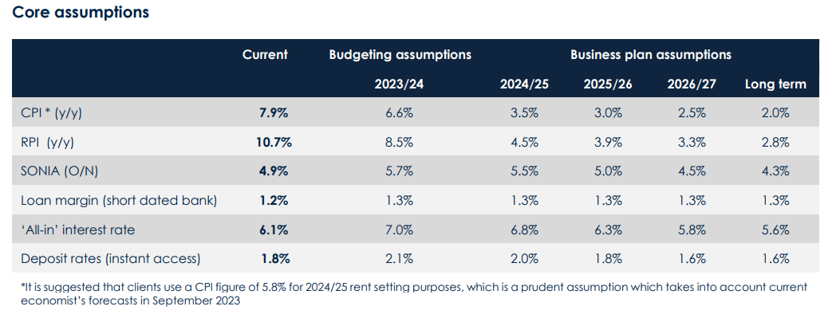
Savills valuation and treasury environment
For reference, our RP based valuation and treasury forecast assumptions
Currently being utilised for security valuations for bank lending to HAs
In the HRA world… pressures feel greater – valuation vs business planning?
Savills Assumptions |  |  | Major Works Cost Growth |  | Maintenance Cost Growth
 | Annual CPI (general) | Q4 CPI (rents) | Nominal | Real | Nominal | Real
2023/24 | 7.00% | 6.70% | 3.80% | -3.20% | 7.75% | 0.75%
2024/25 | 3.00% | 2.75% | 2.75% | -0.25% | 2.25% | -0.75%
2025/26 | 2.00% | 2.00% | 3.75% | 1.75% | 3.00% | 1.00%
2026/27 | 2.00% | 2.00% | 3.25% | 1.25% | 2.75% | 0.75%
2027+ | 2.00% | 2.00% | 2.75% | 0.75% | 2.50% | 0.50%

Slide 26
RTB headlines: sales volumes and replacements
RTB sales 11,000 c0.7% of stock
Replacement homes under 141 agreements consistently failed to match the loss of stock – no “one for one”
Increasing contribution of acquisitions
In no year have starts been > 58%
In only one year more than 50%
Substantial net decline in stock held by local authorities as a result
Sales values since 2012 = £15.5billion
Actual receipts = £8.8billion
Discounts provided to purchasers - £6.7billion
Substantial proportion of discounts provided will have been at a rate which is either
In excess of the required discount to facilitate a purchase
In excess of the rent paid by the tenant/household during their time as a tenant
26

Slide 27
RTB headlines: regional patterns
At a regional level - three separate experiences:
London - sales peaked in 2014.15 and have declined steadily since
Southern regions - sales lower than in the north and midlands, peaked and stabilised/slight decline
Northern and midland regions - consolidated increases to 2016 sustained into the current period
National average discounts are 41% - contrast 36% in the south and 48% in the north.
Even greater variations at the LA level – max 54% (East Midlands) lowest 18% (London).
This form the basis for a serious discussion around regional or local discounts
Average discount rate | No of LAs in 2021.22
<25% | 4
25-35% | 38
35-45% | 63
45%+ | 57
Total | 162
27

Slide 28
RTB headlines: projected replacements to 2030
Sales projected over the period from 2021 to 2030 c100,000
Replacements c43,000, net stock loss 3.61%
No region nor in any authority is there the capability to provide fully at one for one replacement over this period
Net stock loss in north and midlands regions projected over 5%, and in some cases nearer 6%
North/Midlands Replacement rate of only around one third of a property for every one sold
South SW and East… replacement rates are expected to be higher, up to half a unit for very property sold
London, restriction of discounts still represent a lower share of sales price c3/4 of a unit for every property sold
Failure of the programme to replace sold properties
Discounts offered since 2012 substantially outweigh the rent likely to have been paid by those tenants who purchased their properties in that period - estimated £2billion (8,000 homes equivalent)
 | Projected sales | Projected replacements | 9 year total -- %age net loss compared to 2021 stock levels
North East | 6,433 | 1,780 | -4,653 | 5.26%
North West | 5,713 | 1,839 | -3,873 | 4.94%
Yorkshire & Humber | 18,388 | 5,793 | -12,595 | 5.60%
West Midlands | 16,922 | 6,204 | -10,718 | 5.48%
East Midlands | 17,325 | 7,331 | -9,993 | 5.78%
East | 8,273 | 5,081 | -3,192 | 1.92%
London | 15,244 | 9,262 | -5,982 | 1.52%
South East | 6,658 | 3,509 | -3,149 | 2.00%
South West | 4,888 | 2,413 | -2,475 | 2.65%
National | 99,843 | 43,212 | -56,631 | 3.61%
Outside London | 84,600 | 33,950 | -50,649 | 4.30%
Some of our key assumptions
House prices fall 2023/24 – then rise c16% over 5-year period
%age discount grows in short-term
40% matching factor for 141 RTB replacements
Regional development costs (£170k up to £300k)
50% developed on owned land
28

Slide 29
RTB headlines: some policy thoughts
Making the government / LA pooling share available to the 141 replacement programme
Removal of 25% LA pooling requirement –> 10% increase in replacements
Removal of all pooling requirements -> 40% increase in replacements?
Varying the matching %age for receipts to allow reinvestment in lower value areas
Table opposite shows post-discount receipt as a %age of replacement cost – grouped
Expanding the range of organisations and tenures – to include ALMOs and companies and perhaps to include sustainable home ownership models
Accompanying reinvestment receipts with AHP grant
The number 1 “ask” from the sector for development and regeneration
Additionality in regen schemes
Temporarily lifted – or is it?
Localisation of discounts
Strong case for localisation (minimum at regional level)
No of authorities where post-discount receipts are below %age of replacement costs
 | No LAs
 | < 30% | 30%-40% | >40%
North East | 6 | 0 | 0
North West | 10 | 0 | 0
Yorkshire & Humber | 10 | 1 | 1
West Midlands | 12 | 1 | 1
East Midlands | 24 | 0 | 0
East | 6 | 9 | 10
London | 4 | 14 | 11
South East | 12 | 11 | 7
South West | 10 | 2 | 0
National | 94 | 38 | 30
Outside London | 90 | 24 | 19
29

Slide 30
THINKING ABOUT FUTURE CAPACITY

Slide 31
Not enough money in the system?
IN THEORY, there are only four ways we can more money into the system…
Deliver efficiencies
What is the evidence that HRAs are over-providing for costs?
Savings / approaches made 2016-2020 vs deeper savings now?
Unlikely to fundamentally impact future long-term financial health
Allow rents to increase greater over time
Extend CPI+1% to higher rent increases?
Extend use of Affordable and Intermediate tenures?
Challenges in respect of LHA and market rents in many parts of the country
Allow differential rent increase policies around the country?
Greater capital subsidy and grants
Is there any prospect of refurbishment / asset management subsidy? Fire/Building Safety limited?
Reopen the HRA debt settlement
31

Slide 32
Working on a new settlement? (WIP)
Basis of our initial specimen analysis – WORK IN PROGRESS
The 2012 debt settlement was calculated as the Net Present Value of a 30 year projection of the HRA – predicated on the fact that the Decent Homes Standard had been met
Rents less management and maintenance, less major repairs – taking into account property losses from the Right to Buy
The total original settlement was £29.188billion, and where the DHS had not yet been met, adjustments made for amounts arising from ongoing (at that time) ALMO programmes
Some authorities have transferred since (two)
The settlement was based on the following key assumptions:
Rents would increase by inflation plus 0.5% annually
Management & maintenance costs were amended to cover what were analysed to be the costs at the time
Major repairs/depreciation allowances were based on maintenance of the decent homes standard – i.e. that the DHS had already been met
Whilst there was an allowance for aids and adaptations, there were no further allowances for stock improvements
Property losses from the Right to Buy were at a level which reflected activity before 2012, and not following the “reinvigoration” with higher discounts from 2012
Since the time of the settlement, the following have been significant changes:
Rents policy changed to CPI+1% with 4 years of 1% reduction and one year of cap
Capital cost pressures have grown – in particular in relation to fire/building safety and energy efficiency
Property reductions have been significant due to RTB and whilst councils are able to repay debt from their additional receipts, there is a huge competing pressure on financing new build
Key assumptions in this methodology
First calculation is based on re-evaluating the 2012 debt settlement in the light of policy changes:
Rent policy changed to CPI+1% for 2015, then 4 years of minus 1% from 2016-2020, CPI+1% for 2020-2023 then CPI minus 3.1% for 2023.24
The number of properties within the settlement – this is applied as the requirement for replacement build is massive and urgent
Uplift to major repairs expenditure assumptions to reflect: energy efficiency, building and fire safety, estimated at £7,500 per unit across the stock running from 2020-2030
A general uplift in major repairs costs arising from higher maintenance and construction cost inflation (10%)
A general uplift in ongoing maintenance arising from decent homes standards increases of 10%
REDUCE DEBT FROM £29billion to £14billion
Second calculation is a “forward forecast” from 2012 to 2024, bringing up to date for inflation and other general progress i.e. this represents a settlement calculation if there was to be a completely new refreshed settlement for 2024
Incorporation of the other expenditure pressures (as above)
Variations of future rent increases (0.5% or 1% real) – rent policy is absolutely critical to this – CPI+1% significantly increases a revised settlement – would otherwise be much lower
REDUCE DEBT FROM £29billion to £19billion
32

Slide 33
MANAGEMENT FEE AND OTHER ISSUES

Slide 34
Management fees for 2024+…
Approaches to management fee setting
Core differential in approach:
All in including repairs
Separate management fee and repairs management
Capital programme management (not delegated)
Formulae or not?
Linked to inflation and stock numbers by far the most common
Need to separate out inflation drivers this year?
Linked to delivery plan objectives, service improvements, specific need for efficiencies
Interplay with rent and service charge increase – distribution of “savings and efficiencies”
Who leads the negotiation?
How are the revenue pressures affecting fee setting for 2024.25 onwards?

Slide 35
ALMOs – for the 2020s?
ALMOs reducing in number – fewer than 20
Trend to “in-sourcing” gathered pace in 2023
Poor performance in some cases
Poor governance in others
Relationship between Council and ALMO always tends to be the essential factor
Rationale for an ALMO in the 2020s?
Single model from 2002
Diversified models from 2010+ including many providing GF services, and services to third parties (RPs and the private sector)
Regulation as a threat – or an opportunity – for authorities and their ALMOs?
Regulator initially sceptical given challenges at some ALMO authorities - now… board and focus?
PUT SIMPLY…. IS THERE A FUTURE?
WHAT KIND OF ALMO IS YOUR ALMO?
ALMO as landlord provider only: focus specifically on landlord services
ALMO as wider service deliverer: focus on landlord services and provide services to other council departments
ALMO as landlord and strategic housing provider: extension of services to cover General Fund housing: homelessness, maintenance of the Housing Register
ALMO as developer of new homes: extension of ALMO services to cover delivery of new homes in the HRA or ALMO
ALMO as comprehensive diversified provider: incorporation of all related services, landlord, homelessness and elements of housing strategy, maintenance to other departments and the private/RP sectors, new build in the HRA and ALMO, subsidiary companies delivering outsourced services

Slide 36
REGULATION BRIEF DISCUSSION

Slide 37
steve.partridge@savills.com
07968 354948

