Slide 1
COUNCILS WITH ALMOs GROUP
Financial and regulatory update
6 June 2023
Steve Partridge
Director
Savills Affordable Housing Consultancy

Slide 2
Introduction
FINANCE AND BUSINESS PLANNING
REGULATION UPDATE & DISCUSSION
RING FENCE ISSUES
MANAGEMENT FEE ISSUES

Slide 3
FINANCE, BUSINESS PLANNING, RTB and VIABILITY

Slide 4
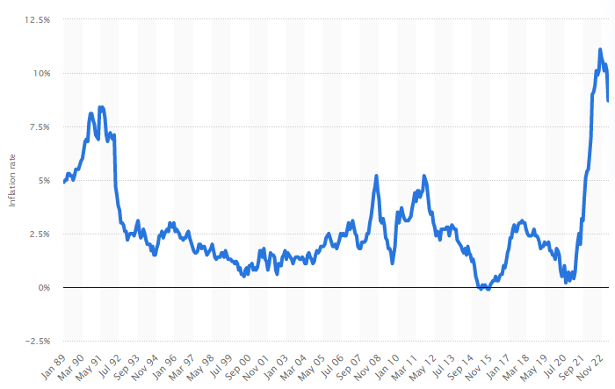
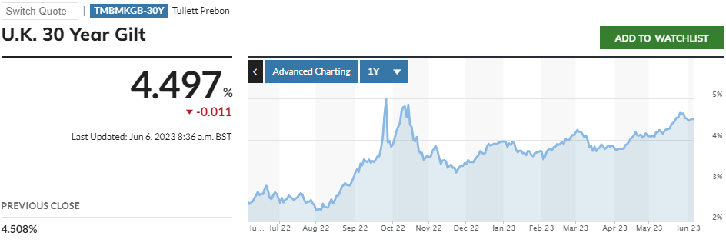
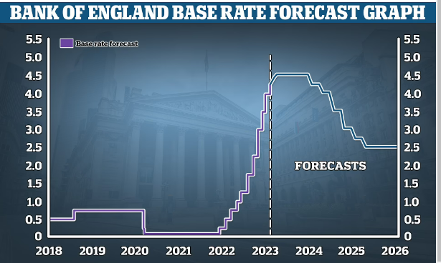
Economic pressures

Slide 5
Introduction
Interlinked research - to support and inform work within trade bodies and DLUHC
Common approach to engagement
Constructed around a “national and regional model” for the HRA
INCOME AND RENTS
Work undertaken late summer/autumn to inform responses to the consultation on rent cap
Focus was on rent cap policies, linked to service charges
No other key and critical areas emerged
EXPENDITURE
Focus on capital expenditure pressures affecting existing stock
Development and regeneration
Revenue pressures (apart from the obvious around inflation) more limited
RIGHT TO BUY
Modelling sales, and replacements
Modelling alternative approaches to discounts
Policy options to increase sustainability

Slide 6
Rents
Range of scenarios covering all of the following (sample opposite)
Cap at 3%, 5%, 7%
Applying to service charges as well as rents
One year or two years
“Catching up” to formula rents via relets, or over 10 years
Disaggregating expenditure inflation between repairs, management, employees, supplies and services
Projecting net surpluses or deficits over a 40 year business plan period
Identifying revenue pressures resulting from different levels of cap
Where it landed…
One-year cap 7%, reletting at target to catch up only, projected net deficits :
1 year -> £321m
2 years -> £664m
5 years -> £1.71bn
40 years -> £15bn -- reducing to £6bn if able to “catch up” over 10 years

Slide 7
Rents funding costs?
Expenditure pressures disaggregated
Employees
Pay award averaged across all HRAs (**)
In practice offers greater pressures for some LAs than others
Construction and major repairs
BCIS record temporary increases well above CPI but longer term average for CPI
Utilities
At the time of writing… wide ranging experiences varying from 50% to over 400%
Capping rents at any level leads to projected deficits
7% for one year with relets only…
3-4% of all operating costs (including major repairs)
5-6% of management and maintenance costs
Unable to be financed from reserves at the national level
Driver | R&M | Management
Employee/pay | 25% | 65%
Contractor | 50% | 15%
Supplies/materials | 25% | 10%
Utilities |  | 10%
 | 2022.23 | 2023.24 | 2024.25 | 2025.26 | 2026.27 | 2027.28
General CPI |  | 10.00% | 6.00% | 4.00% | 2.00% | 2.00%
Pay award ** | 5.00% | 6.00% | 4.50% | 3.00% | 3.00% | 3.00%
Contractors | 8.00% | 10.00% | 7.00% | 4.00% | 3.00% | 3.00%
Supplies/materials | 8.00% | 10.00% | 7.00% | 4.00% | 3.00% | 3.00%
Utilities costs | 30% | 100% | 50% | 5% | 3% | 3%
Construction | 7.00% | 10.00% | 10.00% | 5.00% | 3.00% | 3.00%
Real rents from 2025 |  |  |  | 1.00% | 1.00% | 1.00%
Service charges
Wider range of experiences – ranging from capping to full cost recovery
Any voluntary cap represent (re)introduction of rent pooling
Estimated 15-20p on all rents across the entire stock if capped at 7%

Slide 8
More of a challenge than that…
Additional capital pressures have an impact on revenue if required to be financed within the HRA business plan
Illustratively (for example)…
Fire & Building safety over 5-7 years
Estimated £7.7billion programme]
Part-financed revenue 15%
Part-financed borrowing 85% (assuming below sensible prudential borrowing limits)
Borrowing implications are significant – nationally c£300m pa

Slide 9
Building Safety (1)
Core assumptions applying to the modelling
Number of units in tall buildings estimated @ 1/4/23 227,941
Number of units sheltered/vulnerable person housing @ 1/4/23 290,170
Represents
4% reduction in tall building units since 2019
2% reduction in sheltered units since 2019
Number of tall blocks 3,300 average dwellings 58 per block
Cross-ref to DLUHC statistics – out of est. 6,000 blocks LA/RP
Maximum compliance with fire and building safety standards: unit costs
Unit cost pressures add 20% since 2019
Estimated 15% of the work complete on tall buildings
Estimated <3% completed on sheltered blocks
Work to be completed over 7 years from 2023
 |  | TALL | SHELT
Fire Safety Measures |  | Unit | Unit
Install sprinklers |  | 7,500 | 5,998
Replace fire doors |  | 1,440 | 1,439
Compartmentation works |  | 960 | 961
Improve fire alarm system |  | 419 | 478
Replace cladding |  | 9,451 | 527
TOTALS |  | 19,771 | 9,402
Ongoing management measures |  | pupa | pupa
Building management resources |  | 283 | 243
Additional compliance servicing |  | 152 | 150
Intrusive surveys |  | 11 | 6
BIM |  | 14 | 12
TOTALS |  | 459 | 411

Slide 10
Building Safety (2)
 | TALL | SHELTERED
Fire Safety Measures
Install sprinklers | 1,453,133 | 1,479,408
Replace fire doors | 279,072 | 354,858
Compartmentation works | 186,048 | 236,905
Improve fire alarm system | 81,274 | 117,953
Replace cladding | 1,831,104 | 129,948
TOTALS | 3,830,630 | 2,319,072
Average over all units | 2,468 | 1,494
Average over affected units | 16,805 | 7,992
Ongoing management measures
Building management resources | 451,584 | 493,920
Additional compliance servicing | 241,920 | 304,584
Intrusive surveys | 17,741 | 12,348
BIM | 21,773 | 24,696
TOTALS | 733,018 | 835,548
Average over all units | 472 | 538
Average over affected units | 3,216 | 2,880
TOTAL over 7 tears | 4,563,648 | 3,154,620
Average over all units | 2,940 | 2,032
Average over affected units | 20,021 | 10,872
Essential to recognise that cost estimates are averages which are unlikely to represent anything like a median spend
Costs are much higher or much lower per block
Ongoing measures taken applied over 7 years
Total cost to 2030 estimated at:
£4.6billion tall buildings
£3.1billion sheltered/vulnerable
Total £7.7billion
Compares to previous estimate £8.1billion in 2019
inflation increases offset by reduction in units and work complete
Average / unit across all units from this element of works not funded in the self-financing settlement = £4,972

Slide 11
Energy efficiency and Net Zero Carbon
Assumptions applying to the modelling
Not all properties will require these works - deduct c28,000 built since 2000
EPC C by 2030
Average estimate of properties below EPC C sector wide = 39%
Some of these “just below” EPC C - remediated as part of the general programme – estimated at 25%
Number “far below” EPC C estimated -> 75% of 39% = 454,000 properties
Average improvement works required = £7,700 / unit
Total £3.5billion
Net Zero Carbon
Split into two stages: stage 1 fabric; stage 2 heating/technology – factoring in increasing Heat Pump costs (for example) but assuming that SHDF does not materially impact overall totals
Stage 1 estimates per unit £19,860
Stage 2 estimates per unit £10,400
This leads to a gross NZC cost - reduced for works that are already included in Stock Surveys – 20%
These totals are for achievement by 2050
To achieve earlier costs more as the volume in Stock Surveys reduce and assumption of intensification cost
33% premium to achieve by 2040
50% premium to achieve by 2030
 | 30 year totals to 2052/53 £’m
Initial stock survey – BP average £35k/unit | 54,330
%age NZC in stock survey | 20%
Deduction for Net Zero Carbon | 10,866
Net of NZC – elements | 43,464
Net Zero gross | 34,314
Gross including Net Zero | 77,778
Gross / unit 30 years | 50,106
Amounts not in business plans | £23billion
Increase in costs to 2040 NZC | £9billion
Increase in costs to 2030 NZC | £17billion

Slide 12
Other revenue pressures: cost of living arrears risk
Possible impact on household budgets for low income households
Test the risk of households going into rent arrears as a result of switching spending to other household priorities
Household income spread (from ONS 2020) and household spending composition by quintile (per JRF 2020)
Applied differential inflation to areas such as food, transport
2 household income exemplars
£18,000 -> take home £16,180 -> £311/week – mid-point for lowest quintile
£35,000 -> take home £28,195 -> £542/week – at or just above benefit threshold
The lower the income, the more “essential spend” that is at risk of being diverted
Modelling outputs show
Compared to the 2020 position…
Already risks of arrears given cost of living pressures last 2 years
Increased risk in next 2 years – between one tenth to one fifth of rent potentially diverted to other pressures

Slide 13
Other revenue pressures
Professionalisation
Difficult to work through an estimate…
Estimated cost of staffing in housing management = £2.2billion
Proportion of staff affected c25% ??
Pay premium for professionalisation c10% ??
Would result in £50-100million – though highly speculative
Feedback ongoing
Additional staff re rent collection and arrears
In the light of net deficit pressures from inflation, this may be an “extra and over” cost
Consumer Regulation additional pressures
Feedback generally that this will be able to be contained
No-one wanted to admit that their LA/ALMO was unable to meet consumer standards now without extra funding
13

Slide 14
New build / development
Estimated new build programmes across HRA delivery
£625million - £700million per year
Based on 2,500 homes annually
Construction cost inflation -> need for additional subsidy support to ensure viability
Unit costs already up towards £250,000 per home
If construction inflation = 10% (lower end of experience) - > subsidy increase £25,000 -- RTB matching … 47%-50%
If construction inflation = 18% (higher end of experience) - > subsidy increase £45,000 -- RTB matching … 52%-55%
Interest rate changes
Add to delivery costs
Change from 3% to 4%
Between £12-18,000 additional subsidy per home
(depending on extent of use of own land)
14

Slide 15
RTB headlines: sales volumes and replacements
RTB sales 11,000 c0.7% of stock
Replacement homes under 141 agreements consistently failed to match the loss of stock – no “one for one”
Increasing contribution of acquisitions
In no year have starts been > 58%
In only one year more than 50%
Substantial net decline in stock held by local authorities as a result
Sales values since 2012 = £15.5billion
Actual receipts = £8.8billion
Discounts provided to purchasers - £6.7billion
Substantial proportion of discounts provided will have been at a rate which is either
In excess of the required discount to facilitate a purchase
In excess of the rent paid by the tenant/household during their time as a tenant
15

Slide 16
RTB headlines: regional patterns
At a regional level - three separate experiences:
London - sales peaked in 2014.15 and have declined steadily since
Southern regions - sales lower than in the north and midlands, peaked and stabilised/slight decline
Northern and midland regions - consolidated increases to 2016 sustained into the current period
National average discounts are 41% - contrast 36% in the south and 48% in the north.
Even greater variations at the LA level – max 54% (East Midlands) lowest 18% (London).
This form the basis for a serious discussion around regional or local discounts
Average discount rate | No of LAs in 2021.22
<25% | 4
25-35% | 38
35-45% | 63
45%+ | 57
Total | 162
16

Slide 17
RTB headlines: projected replacements to 2030
Sales projected over the period from 2021 to 2030 c100,000
Replacements c43,000, net stock loss 3.61%
No region nor in any authority is there the capability to provide fully at one for one replacement over this period
Net stock loss in north and midlands regions projected over 5%, and in some cases nearer 6%
Replacement rate of only around one third of a property for every one sold
South and East… replacement rates are expected to be higher, up to half a unit for very property sold
London, restriction of discounts still represent a lower share of sales price c3/4 of a unit for every property sold
Failure of the programme to replace sold properties striking in the context of the level of discounts
Gross level of discounts offered since 2012 substantially outweigh the rent likely to have been paid by those tenants who purchased their properties in that period - estimated £2billion (8,000 homes equivalent)
Is there a Levelling Up issue here?
Cross-subsidisation from those waiting for a rented home to home-owners disproportionately impacts lower value areas
 | Projected sales | Projected replacements | 9 year total -- %age net loss compared to 2021 stock levels
North East | 6,433 | 1,780 | -4,653 | 5.26%
North West | 5,713 | 1,839 | -3,873 | 4.94%
Yorkshire & Humber | 18,388 | 5,793 | -12,595 | 5.60%
West Midlands | 16,922 | 6,204 | -10,718 | 5.48%
East Midlands | 17,325 | 7,331 | -9,993 | 5.78%
East | 8,273 | 5,081 | -3,192 | 1.92%
London | 15,244 | 9,262 | -5,982 | 1.52%
South East | 6,658 | 3,509 | -3,149 | 2.00%
South West | 4,888 | 2,413 | -2,475 | 2.65%
National | 99,843 | 43,212 | -56,631 | 3.61%
Outside London | 84,600 | 33,950 | -50,649 | 4.30%
Some of the key assumptions
House prices fall 2023/24 – then rise c16% over 5-year period, then CPI
%age discount grows in short-term
40% matching factor
Regional development costs (£170k up to £300k)
50% own (LA) land
17

Slide 18
RTB headlines: some policy thoughts
Making the government / LA pooling share available to the 141 replacement programme
Removal of 25% LA pooling requirement –> 10% increase in replacements
Removal of all pooling requirements -> 40% increase in replacements
Varying the matching %age for borrowing and receipts to allow reinvestment in lower value areas
Table opposite shows post-discount receipt as a %age of replacement cost – grouped
Expanding the range of organisations – to include ALMOs and companies
Expanding the range of tenures – perhaps to include sustainable home ownership models
Accompanying reinvestment receipts with AHP grant
The number 1 “ask” from the sector for development and regeneration
Additionality
Utilise 141 receipts for replacement of negatively valued/unsustainable stock
Linked to AHP additionality
Localisation of discounts - further modelling within the research report in relation to
Example… if discounts reduced 15% all LAs -> 23 authorities in North and Midlands could increase their replacements programme – sales would reduce but not by as much as replacements would increase
Strong case for localisation (minimum at regional level)
No of authorities where post-discount receipts are below %age of replacement costs
 | No LAs
 | < 30% | 30%-40% | >40%
North East | 6 | 0 | 0
North West | 10 | 0 | 0
Yorkshire & Humber | 10 | 1 | 1
West Midlands | 12 | 1 | 1
East Midlands | 24 | 0 | 0
East | 6 | 9 | 10
London | 4 | 14 | 11
South East | 12 | 11 | 7
South West | 10 | 2 | 0
National | 94 | 38 | 30
Outside London | 90 | 24 | 19
18

Slide 19
Summary: Future consultations
Future rents to cover future costs…?
Catch up debate gone away
Consultation on future rent increase policy – CPI+1% or ...?
Has the one year cap made CPI+1% more likely?
Decent Homes consultation
Drivers from the private sector and from damp and mould
Decent Homes 2 thinking finally on its way
Changes to individual criteria
Discussion and debate on “tightening”, closing flexibility?
Context of forthcoming General Election – and parties settling their policies and manifestos
What and where are the key areas to influence?
19

Slide 20
HRA Business Planning Environment
Almost “unique” set of circumstances affecting budgeting and business planning for operational costs in the next 2-3 years
Unprecedented set of inflation drivers
Supply chain
Labour and sub-contractor shortages
Imported suppliers / value of £
Energy costs
Cost of Living -> inflation in pay awards
Need to differentiate between types of costs – in order to determine overall inflation
Research with LAs – min 10% - up to 15-16% in some cases
National modelling | 2023.24 | 2024.25 | 2025.26 | 2026.27 | 2027.28
General CPI | 10% | 6% | 4% | 2% | 2%
Pay award | 6% | 4% | 3% | 3% | 3%
Contractors | 10% | 7% | 4% | 3% | 3%
Supplies/materials | 10% | 7% | 4% | 3% | 3%
Utilities costs | 100% | 50% | 5% | 3% | 3%
Construction | 10% | 7% | 4% | 3% | 3%
RP Valuations | 2023.24 | 2024.25 | 2025.26 | 2026.27 | 2027.28
General CPI | 10.0% | 5.1% | 4.0% | 2.0% | 2.0%
Pay award | 10.0% | 5.1% | 4.0% | 3.0% | 3.0%
Contractors | 8.4% | 4.1% | 3.2% | 3.0% | 3.0%
Supplies/materials | 8.4% | 4.1% | 3.2% | 3.0% | 3.0%
Utilities costs | 10.0% | 5.1% | 4.0% | 3.0% | 3.0%
Construction | 9.1% | 4.1% | 4.0% | 3.5% | 3.0%

Slide 21
HRA Viability: discussion
Debt cap release in 2018 – focus on new build ?
BUT
Self financing debt linked to what was considered to be expenditure needs as at 2012-2042
Decent homes only – no backlog (except in specific cases)
4 years of rent cuts
Rent restriction 2023 and maybe in future years
Building and fire safety
Possible Decent Homes 2
All in all – rents being asked to cover much more expenditure than was anticipated in 2012
Need for more capital subsidy and support – but is this a case for reopening the debt settlement?
Expect greater focus on existing stock – and on regeneration and redevelopment

Slide 22
REGULATION UPDATE and DISCUSSION

Slide 23
Changing Regulation Landscape
Regulator of Social Housing (RSH)
Focus on Social Landlords
Economic and Consumer Standards (and judgements)
In-Depth Assessments & (new) Consumer Standards Inspections
Referrals & MOU
The Housing Ombudsman
(THO)
Focus on Tenants
New Complaints Code (Landlords self-assess)
New ‘name and shame’ on maladministration findings
Building Safety Regulator
(new)
Focus on tall buildings
Part of HSE
Focus on Safety not just Compliance

Slide 24
Consumer Regulation for Local Authorities
Consumer standards
Home standard
Tenant Involvement and Empowerment standard
Tenancy standard
Neighbourhood and Community standard
Economic standards
Rent Standard
Governance and Viability
Value for Money
Social Housing (Regulation) Bill
Update Standards
Removal of Serious Detriment test
4 yearly inspection
Local authorities and RPs
Can commission work and issue fines
Tenant Satisfaction Measures
Safety focus
Landlord Responsible person
Drivers for consumer focus
Hackitt Review post-Grenfell
Standards and Complaints
Covid
KEY FOCUS ON TENANTS
Referrals to RSH and complaints to Housing Ombudsman rising

Slide 25
Fire and Building Safety
Building Safety Act 2022
Building Safety Regulator
Electrical testing
Tall and Vulnerable Buildings
Building Safety Cases and the Building Safety Manager
Golden Thread
Accountable Person
Resident Engagement
What will it cost? £7,500 per property across the entire HRA stock – c£10-15billion?

Slide 26
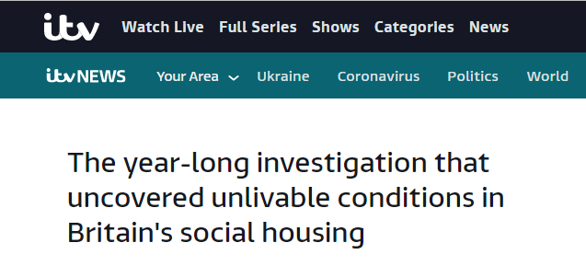
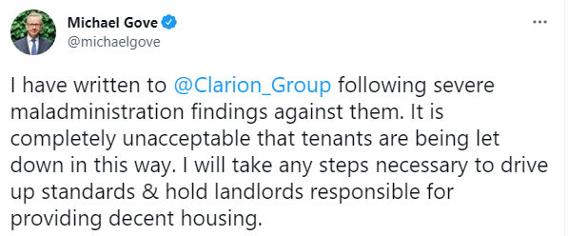
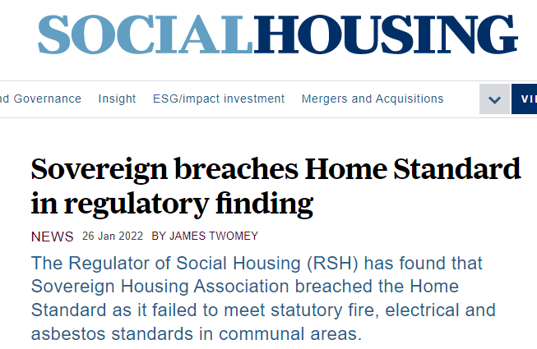
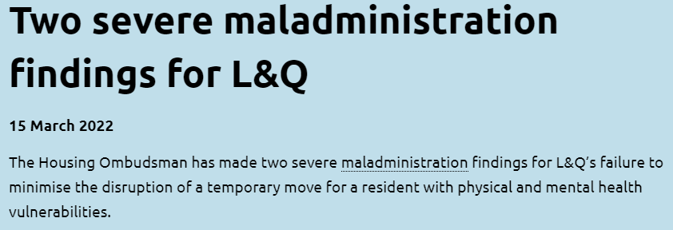
Headlines

Slide 27
Consumer Regulation
Tenant Satisfaction Measures (TSMs) implemented from April. Collecting the first round of data in April 2024
RSH in the process of developing new consumer standards to be consulted on later this year (June?) for implementation in April 2024
Continuing co-regulation – combined economic and consumer IDAs for RPs
Consumer standards inspections for LAs
Ability to issue Code of Practice on consumer standards
DLUHC Consultation on mutual exchange and tenant involvement closed 30 March – RSH will be directed on this standard

Slide 28
Future Consumer Standards
The RSH has set out the themes it thinks its Consumer Standards will cover. Their aim is to set out the right outcomes for landlords to deliver for tenants and maintain strong alignment with existing standards.
The new Tenant Satisfaction Measures, whose implementation is supported by the new TSM Standard, are aligned with the first five of these themes.
Theme | Link to current standards
Safety | Home
Quality | Home
Neighbourhood | Neighbourhood & Community
Transparency | Tenant Involvement & Empowerment
Engagement & Accountability
Tenancy | Tenancy
Consistent message re “should prepare now” for changing Consumer Standards and proactive regulation

Slide 29
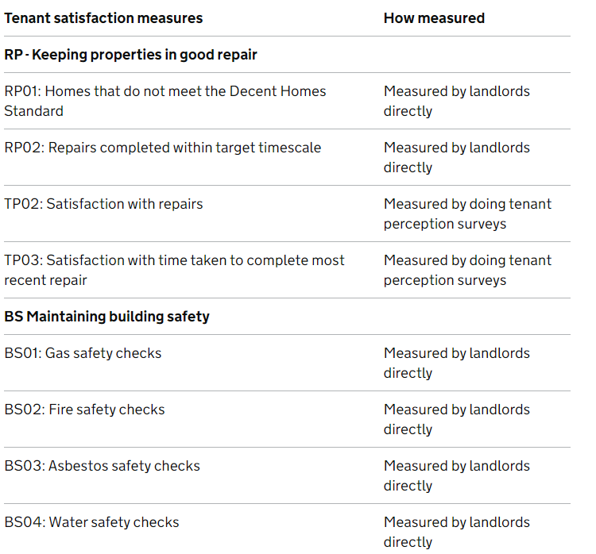
Tenant Satisfaction Measures
Measured from April 2023 – reported from April 2024
All social landlord providers – statutory
Management info and… perception…
No hiding place?

Slide 30
Themes of getting it wrong (where we come in…)
Regulatory Notices (RNs) for Serious Detriment have been issued to all types of registered providers against the consumer standards
Regulatory Notices to Local Authorities have generally been in relation to the Home Standard.
Annual Consumer Regulation Review 2020 and 2021 (published by RSH September) themes:
Local authorities failing to understand what is required of them – either the legislative requirements or their role in ensuring compliance
Weaknesses in housing management services delivered by a third party (e.g. where services have been contracted out to an ALMO)
Not putting things right (i.e. not responding/learning from complaints)
Data weaknesses are a key and common cause of problems: data about everything

Slide 31
Sector Risk Profile 2022
Key Themes
Financial and macro economic.
Rents, inflation and interest costs, supply chain and labour.
Stock condition and investment
Current quality, future demands – DHS, decarbonisation, safety
Services to tenants
Understanding tenants needs, learning from recent experience.
Development and sales
Economics, supply chain, managing commitments, understanding delivery structures.
Cyber and data
Cyberattacks, data integrity, data coverage
Reputational
Stock condition, tenant relations, investment, remuneration
Strategic Risks Macroeconomic and financial environment Delivering against expectations Diversification Access to labour and skills Counterparty risk | Operational Risks: Existing Stock and Service Delivery Existing stock quality Delivering services to tenants Heath and safety Cost and inflation Rent Setting Rental income and arrears Data security Data integrity Supported Housing
Finance and Treasury Management Existing debt New debt Alternative funding models Pensions Fraud | Operational Risks – Development Low-cost home ownership and market sales Construction process risk

Slide 32
Regulator messaging Q2 2023…
Progress…
TSMs and consultation on revised consumer standards imminent
Outcome – focused regulation – Code of Practice
Inspections to be focused on how LAs provide evidence of own assurance around compliance – this is Actual Assurance, not theoretical – but will not (e.g.) extend to property inspections
1st wave of pilots complete and general comfort with outcomes
2nd wave ongoing – focus on talking to tenants, data and information triangulation
Focus on Culture, Data, Systems, Processes
Culture - set from the top “operational” becomes “strategic”
Repairs and barriers to access
Data – dashboards – triaging of issues and cases, board/council oversight, EDI focus especially on service access
Will also be a REACTIVE route for enforcement
Also an ongoing offer from the Regulator to speak to LAs (individually or in groups)
Inspection “grading” tbc – “ordering of inspections” also tbc – be ready!
Warning on “lack of resources” as “no excuse”…

Slide 33
Preparation – don’t wait for the legislation
Get the basics right - focus on the core services to tenants and ensure data is in order
Ensure clarity of responsibility between ALMO and LA backed by effective reporting / assurance
Identify a ‘responsible person’ for consumer standards compliance and clarify roles of senior staff (inc. nominated person for H&S)
Accountability through transparency is key and can be addressed now, so have this on the agenda and think about how you will verify KPI results –prepare for the Tenant Satisfaction Measures
Raise awareness of the consumer standards as proactive regulation is coming
Review evidence of compliance with the standards
Some themes from early Consumer Standards Reviews for LAs with ALMOs…
Golden thread works within the ALMO
“Client” management and oversight
Member focus at Cabinet level?
Knowledge and assurance within the local authority?

Slide 34
Regulation Implementation Plan: current challenges
Key challenges for ALMO authorities
Designing the Governance and Accountability Framework
Ensuring members and senior directors within the authority are sighted
Relationship with the ALMO board and senior leadership
No right or wrong way – but might there be an implication to boost the client role?
And if so how might that work?

Slide 35
Governance and Assurance Framework (1)
“Delegated” model
Full delegation of all services, compliance and assurance to the ALMO board
ALMO board receives all data, performance and assurance around compliance
Council assurance via ALMO reporting into enhanced Partnership Board
Role of “client officers” to provide sense check/second check on information prepared by ALMO officers
Cabinet
(or cabinet committee)
Partnership Board
ALMO Board
Sub-board / panel (H&S)
Sub-panel – Tenant Empowerment
Council client side officers collating data
Compliance and Assurance reporting
Data and service statistics

Slide 36
Governance and Assurance Framework (2)
“Client-lead” model
Delegation of all services to the ALMO board
Primary responsibility for compliance reporting is with council officers
ALMO board receives all data, performance and assurance around compliance but does not necessarily have a role reporting these to the cabinet/leadership
Council assurance via its own officers collating and providing compliance data up to cabinet/committee
More proactive assurance role for “client officers”
Cabinet
(or cabinet committee)
ALMO Board
Sub-board / panel (H&S)
Sub-panel – Tenant Empowerment
Officer-based partnership panel
Council client side officers preparing compliance reporting
Data and performance reporting, service statistics

Slide 37
Governance and Assurance Framework: other considerations?
“ The main challenge in ALMO authorities is that council leadership teams have not been sighted on what is going on with the landlord service – that is not a reason for getting rid of an ALMO – it is a reason for getting it right going forward “
Is there a need for a new or revised cabinet panel or committee to take a member lead on receiving assurance?
Is there a role for external independent support, tenant and resident involvement in such a panel or committee?
How might such a panel fit with the Council’s constitution?
If pursuing a “client light” fully delegated model, key to ensure robust reporting up through the ALMO chain?
Making sure the Council has sufficient assurance that this process is robust?
Open opportunities for council officers and members to attend ALMO processes and meetings?
If there is a Partnership Board – what is the optimal format for the Framework that you have in place?
Role of tenants and tenant empowerment in the framework
Role of Council Scrutiny – may need a rethink in the context of the assurance framework

Slide 38
Governance and Assurance Framework: discussion
Questions
What approaches are currently in place for partnership board and panels? Do these need to change?
What plans are you beginning to put into place?
What have been the challenges?
Have you changed the way the ALMO board operates in response to the regulatory agenda?
Does anyone think they have it sorted?

Slide 39
HRA RING-FENCE ISSUES

Slide 40
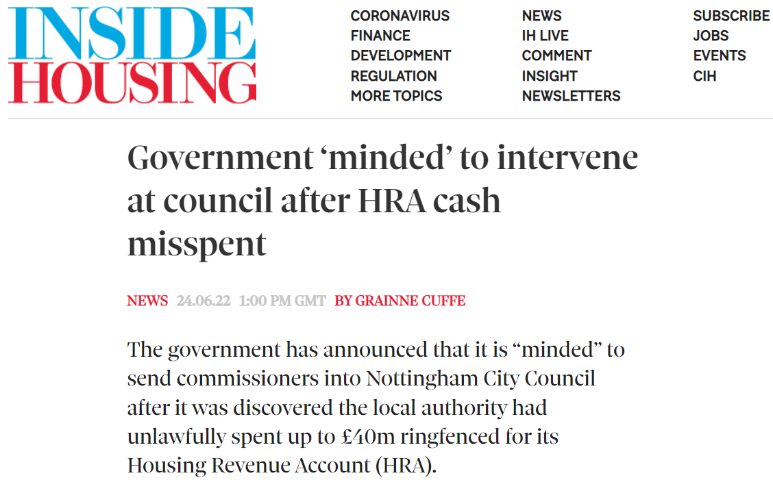
The Nottingham Case

Slide 41
Maintaining the integrity of the HRA Ring-Fence
Increasing focus on integrity of the HRA ring-fence due to the Nottingham case
More and more local authorities examining how they might have “blurred” the line
Nottingham will not be the only case that comes to light
Why is this happening?
Past and continuing financial challenges to the General Fund
Decisions taken in absence of consideration of the HRA and the potential impact on the integrity of the ring-fence
Failure to ensure HRA funds entrusted to an ALMO are applied wholly to HRA activities
DLUHC are fully aware of the issue and will take action if necessary as we have seen in Nottingham

Slide 42
What does the “Who Benefits” Test mean in practice?
Protecting “tenants’ monies” whilst also ensuring Council Tax payers are not subsidising the HRA by making sure charges to and from the HRA are:
Compliant with the law and guidance
Equitable
Justifiable
Transparent
Evidenced (supported by SLAs, clear basis of calculation)
This applies equally to HRA funds entrusted to ALMOs and other external service providers

Slide 43
What does the “Who Benefits” Test mean in practice?
Legitimate charges to HRA from GF in Council’s role as Landlord
Council
Tenant
Rent/Service Charges
GF cannot “double charge” tenants for services provided to all.
Person
GF Services provided to all residents/Council Tax Payers irrespective of tenure
Council Tax Payer
Council Tax

Slide 44
Undermining the integrity of the Ring-Fence: some examples
Grounds maintenance charges:
No SLA
No evidence as to how charge to HRA is calculated
Ending of rebate to take account of RTB
Street lighting
Charging of a non-core service
No justification or evidence for the basis of the charge to the HRA
Support services (e.g. finance, HR, IT)
No SLA
No evidence for the basis of the charge to the HRA
Evidence and working papers go back many years without update

Slide 45
Undermining the integrity of the Ring-Fence: some examples
Cessation of reimbursement of the HRA for HRA funded teams undertaking non-HRA activities
Income generated from an HRA asset going to the General Fund
The HRA being charged for a General Fund service provided free to people on benefits where some customers happen to be HRA tenants
ALMO unable to account for how HRA funds have been applied to HRA activities and not spent on non-HRA activities
“Dividend” from ALMO paid to General Fund

Slide 46
What do local authorities need to do?
Ensure members and officers (and ALMO Boards) are aware of the HRA ring-fence and that the impact on the HRA is fully considered before any decisions are made
Consider who speaks for tenants when decisions are made affecting the HRA (an “HRA champion”) and take challenges to current/proposed treatment seriously
Ensure charges to the HRA are evidenced and there is a fair basis for their calculation and also consider whether the HRA should be reimbursed for any non-HRA activities undertaken
Ensure the ALMO (and any other service providers) can properly account for how they apply/expend HRA monies entrusted to them
Any questions… anything to get a view on?

Slide 47
ALMO DIVERSIFICATION, MANAGEMENT FEE AND OTHER ISSUES

Slide 48
ALMOs – for the 2020s?
ALMOs reducing in number – just over 20
Trend to “in-sourcing”
Poor performance in some cases
Poor governance in others
Relationship between Council and ALMO always tends to be the essential factor
Rationale for an ALMO in the 2020s?
Single model from 2002
Diversified models from 2010+ including many providing GF services, and services to third parties (RPs and the private sector), new build and RP in their own right
As we’ve discussed, regulation could be seen as a threat – or an opportunity – for authorities and their ALMOs?
Regulator initially sceptical given challenges at some ALMO authorities
Now… board and organisational focus?
WHAT KIND OF ALMO IS YOUR ALMO?
ALMO as landlord provider only: focus specifically on landlord services
ALMO as wider service deliverer: focus on landlord services and provide services to other council departments
ALMO as landlord and strategic housing provider: extension of services to cover General Fund housing: homelessness, maintenance of the Housing Register
ALMO as developer of new homes: extension of ALMO services to cover delivery of new homes in the HRA or ALMO
ALMO as comprehensive diversified provider: incorporation of all related services, landlord, homelessness and elements of housing strategy, maintenance to other departments and the private/RP sectors, new build in the HRA and ALMO, subsidiary companies delivering outsourced services

Slide 49
For ALMOs, the challenges may be significant
Council officer and member accountability on regulation and building safety
Assurance and compliance reporting therefore must be to the cabinet/Council via corporate leadership teams
Or some form of delegated panel or committee
Highlights key questions for ALMO boards in the 2020s
What is the added value that the ALMO and its board bring to the HRA service?
What is the added value that the ALMO and its board are able to bring to wider service delivery?
What are the relative strengths and weaknesses of the “delegated” model?
The additional costs of delivering via an ALMO can sometimes be significant – can these be justified in the context of performance, quality and delivery?
Does the length of the arm need to change as a result of changing regulatory times?
What are the opportunities to offer a comprehensive extra-landlord service for the Council and generate additional value (i.e. income)?

Slide 50
Management fees for 2023+…
Approaches to management fee setting
Core differential in approach:
All in including repairs
Separate management fee and repairs management
Capital programme management (not delegated)
Formulae or not?
Linked to inflation and stock numbers by far the most common
Need to separate out inflation drivers this year?
Linked to delivery plan objectives, service improvements, specific need for efficiencies
Interplay with rent and service charge increase – distribution of “savings and efficiencies”
Who leads the negotiation?
With more services from the General Fund – need to ensure that fees are able to be disaggregated
ALMOs must be able to demonstrate an appropriate allocation and apportionment of their overheads

Slide 51
Management fee and ALMO surpluses
Surpluses arise as ALMOs do not spend the full management fee income on service expenditure
Variety of approaches to dealing with ALMO surpluses
Typical (most common?) for Council and ALMO to discuss use of surpluses in future years as part of the delivery and business plans – ALMO surpluses are generally not derived from anything other than efficiencies or underspends
Return of surpluses to the HRA for determination within the HRA budget process – this seems to be less typical
What are ALMO surpluses for? And why would they be required to be set aside?
Where ALMOs have external undertakings outside of the HRA and General Fund management fee mechanisms…
Is there are a case for separate policy towards retention of surpluses – especially if there is stock held directly in the ALMO or if the ALMO is a RP in its own right?
Feels essential that there is clear disaggregation of where surpluses arise - not least for tax reasons
Some ALMOs have built surpluses that appear to be quite large – a plan for dealing with these above a minimum would seem appropriate – i.e. spending or investing them

Slide 52
Any final points, questions or issues?

Slide 53
steve.partridge@savills.com
07968 354948

